Slide 1
Codes

Slide 2
Binary code for Decimal number
Binary code are appropriate for internal computation of a digital system
People prefer to deal with decimal number
External interface of a digital system accepts/process/displays decimal number directly
Binary code for decimal digit requires minimum four bits.
Different code can obtain by arranging four or more bit
Binary Code
Weighted Code
Non Weighted Code
each position of the number represents a specific weight
Binary Code, Octal Code, Decimal Code, Hexadecimal code,
Binary Coded Decimal (BCD) Code
each position within the binary number is not assigned a fixed value
Excess3 code, Gray code

Slide 3
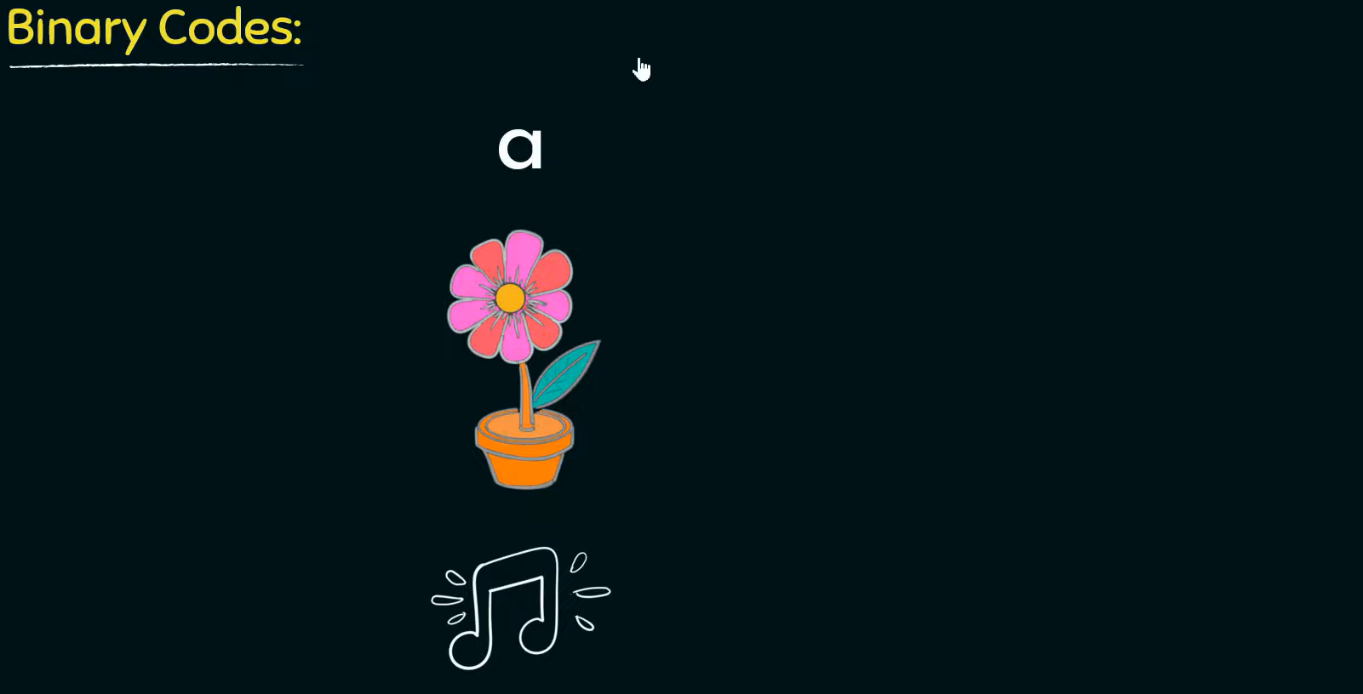
Notes:
Any information, maybe a character, an image or audio, need to be converted to a sequence of zeros and ones in order to be stored in computers.

Slide 4
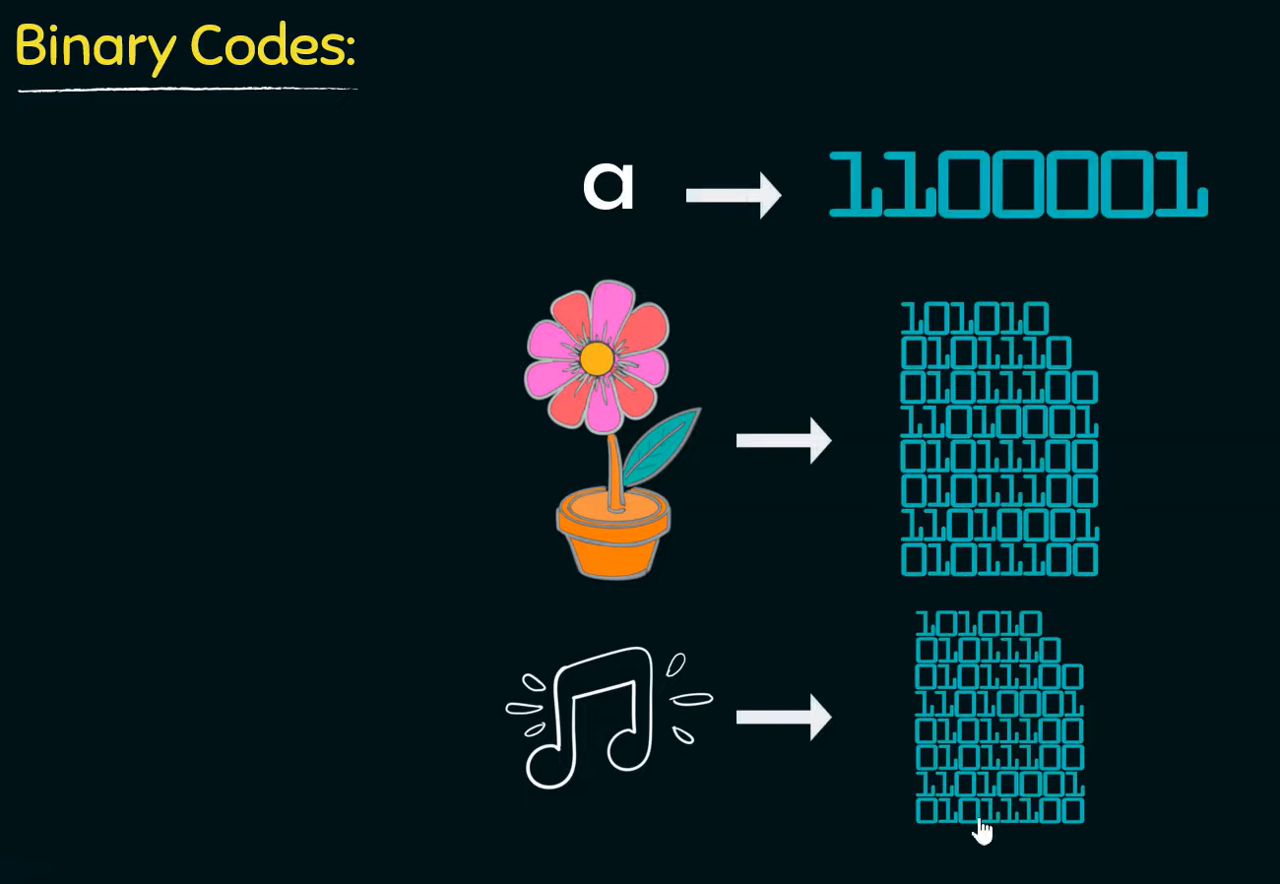

Slide 5
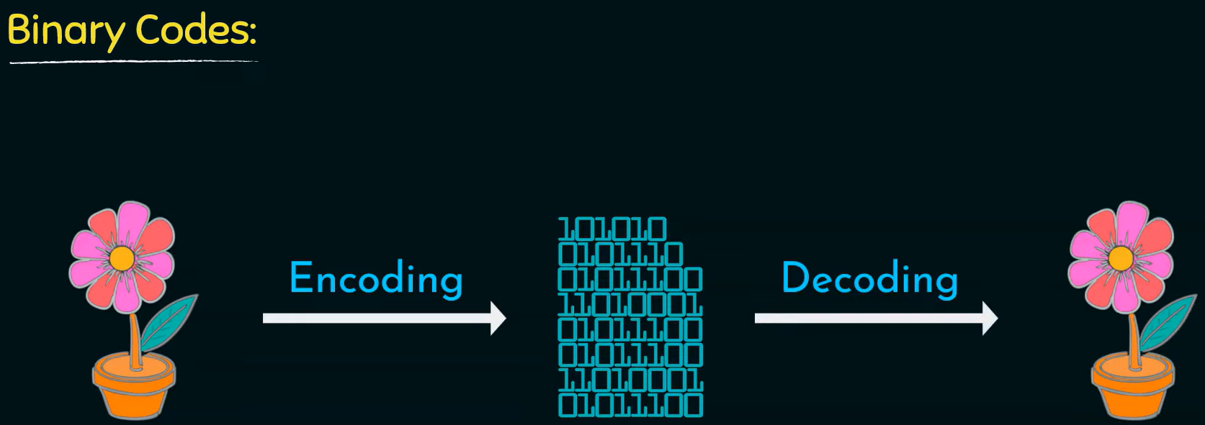

Slide 6
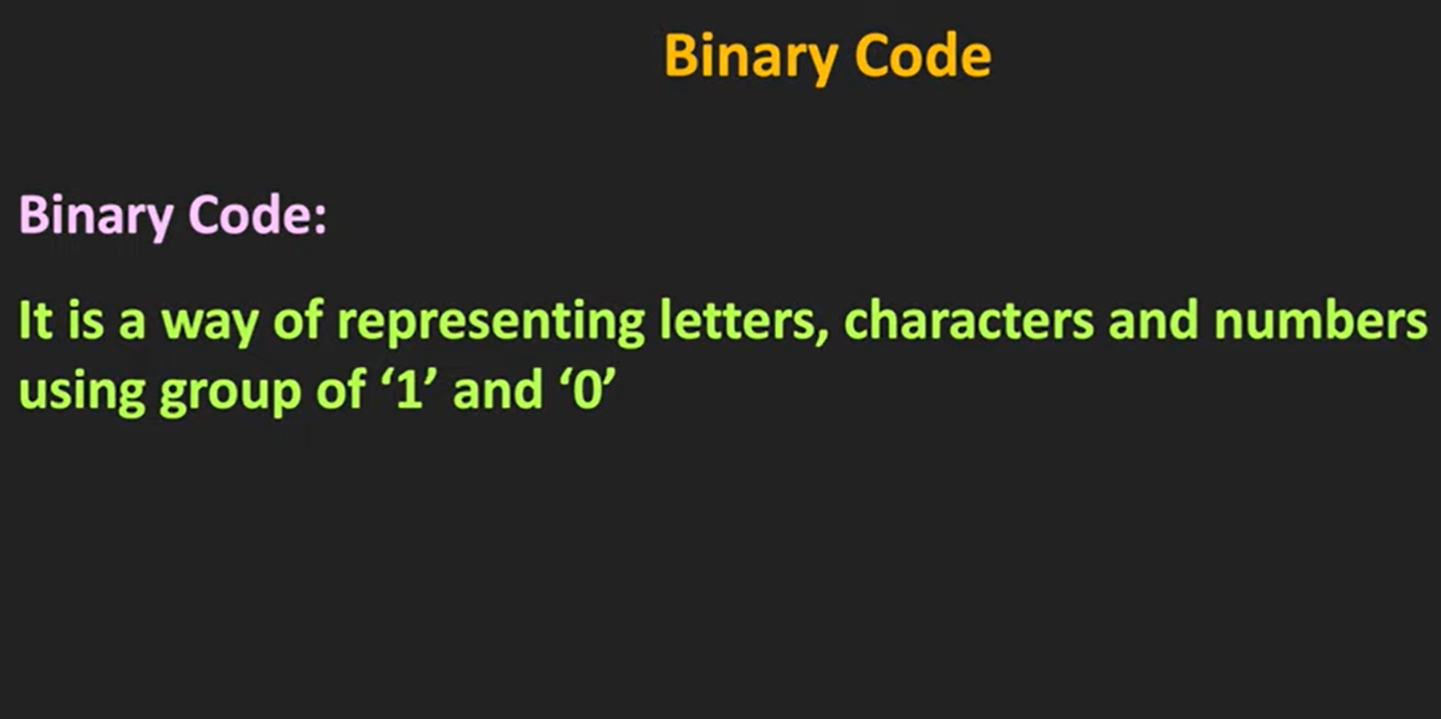
Notes:
https://www.youtube.com/watch?v=ZNFyOSHh8P0

Slide 7
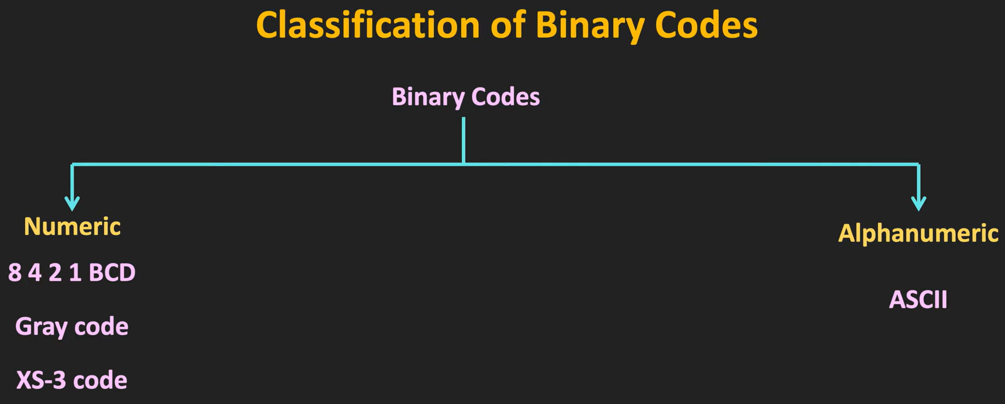

Slide 8
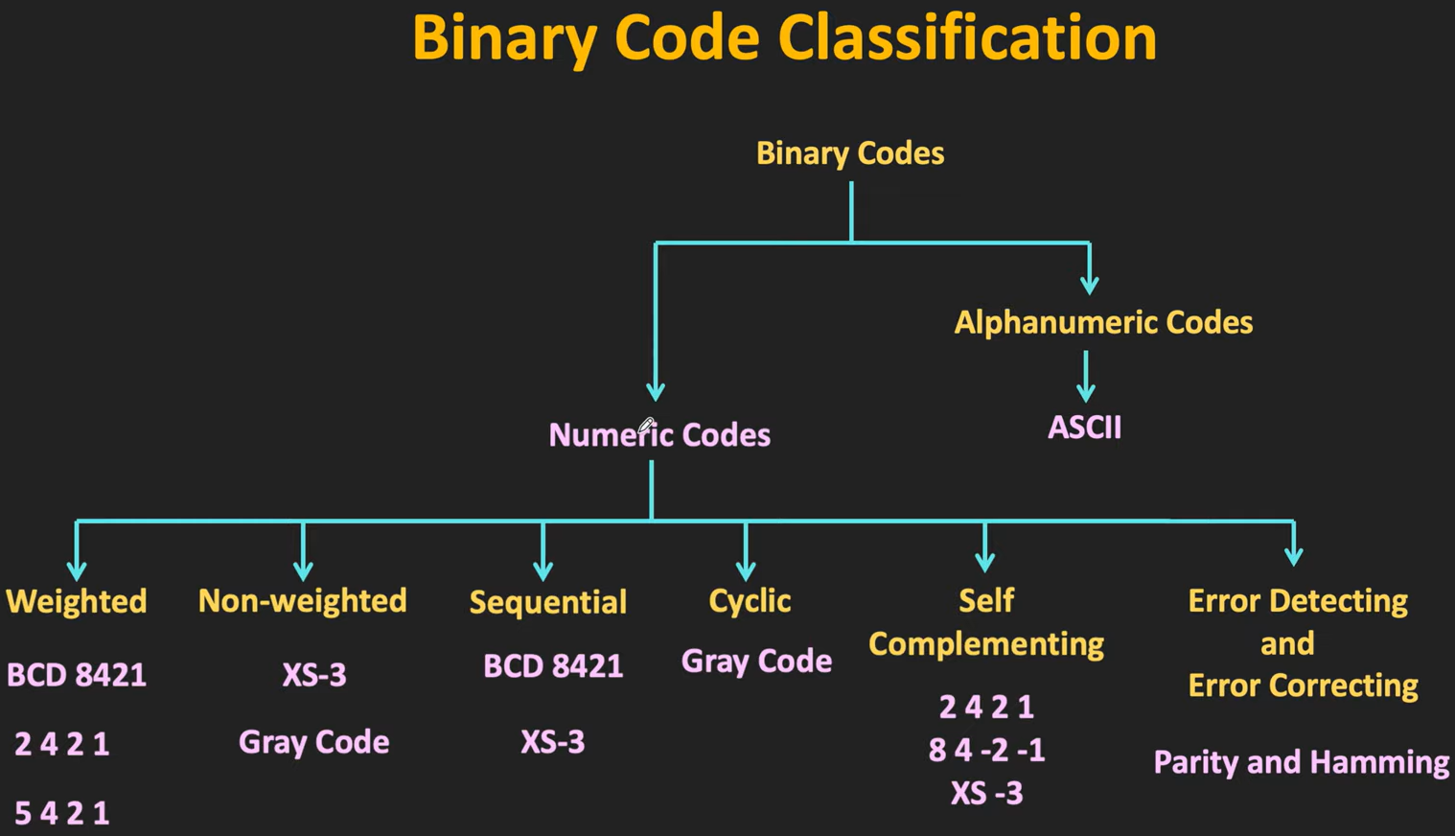

Slide 9
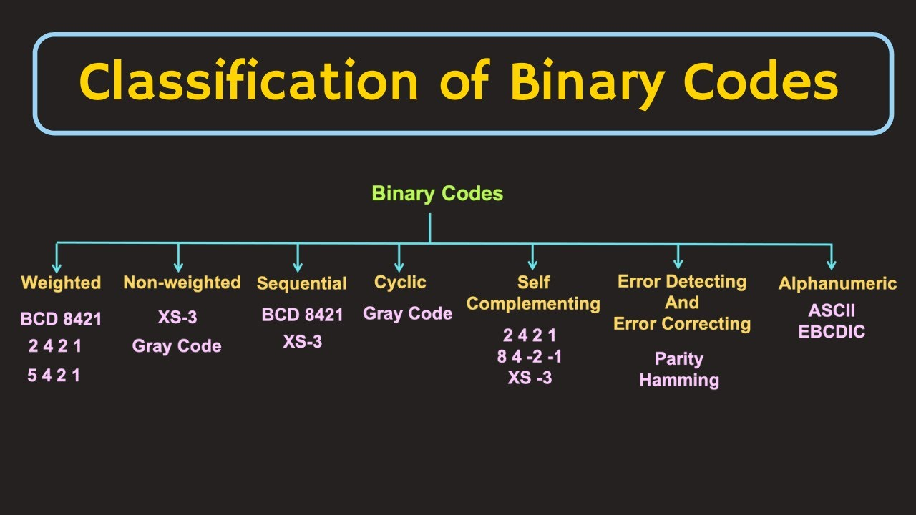

Slide 10
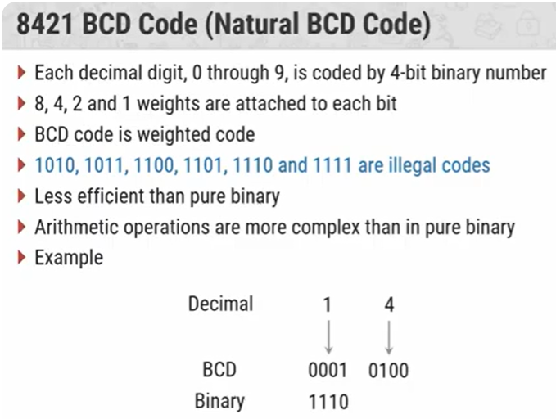

Slide 11
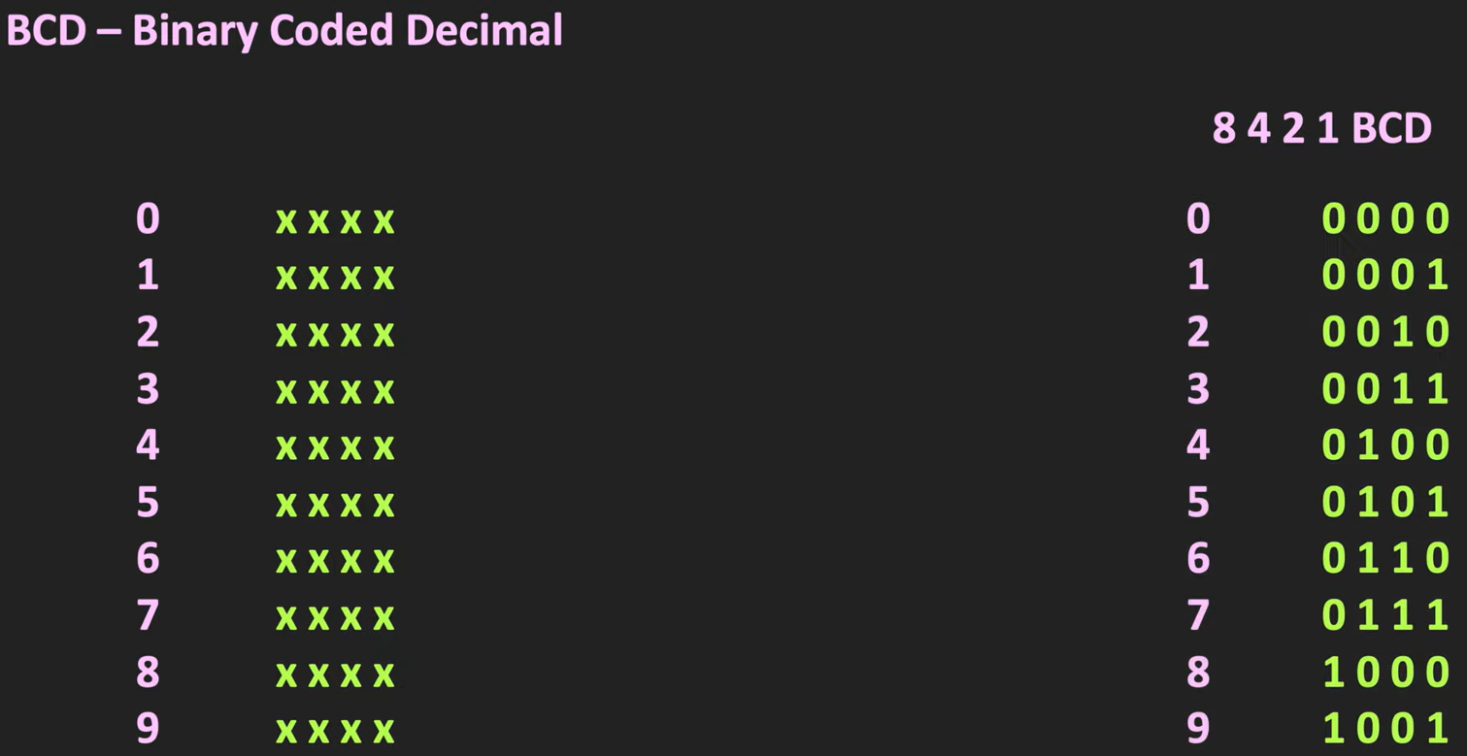

Slide 12
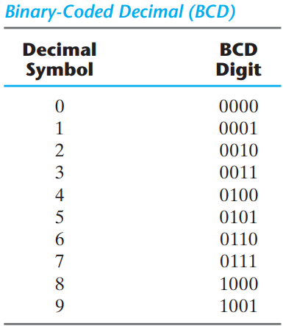

Slide 13
Table gives the four‐bit code for one decimal digit. A number with k decimal digits will require 4k bits in BCD.
Decimal 396 is represented in BCD with 12 bits as 0011 1001 0110, with each group of 4 bits representing one decimal digit.
A decimal number in BCD is the same as its equivalent binary number only when the number is between 0 and 9.
A BCD number greater than 10 looks different from its equivalent binary number, even though both contain 1’s and 0’s. Moreover, the binary combinations 1010 through 1111 are not used and have no meaning in BCD.

Slide 14
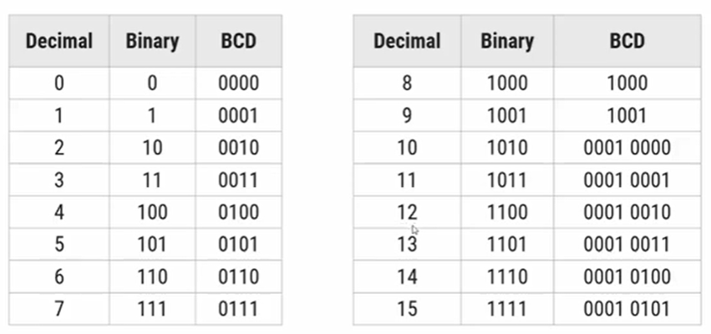

Slide 15
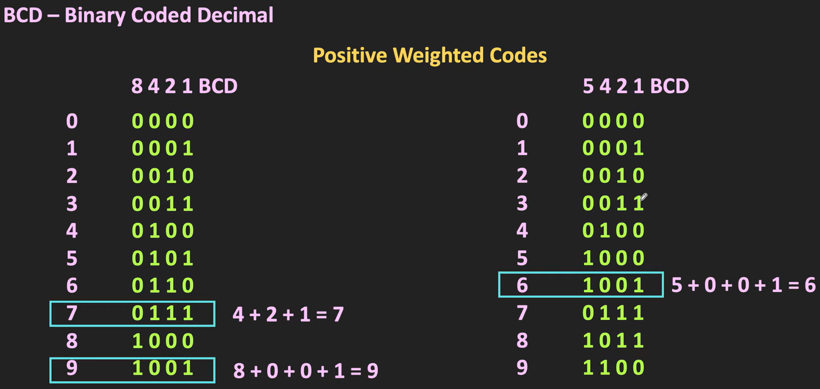

Slide 16
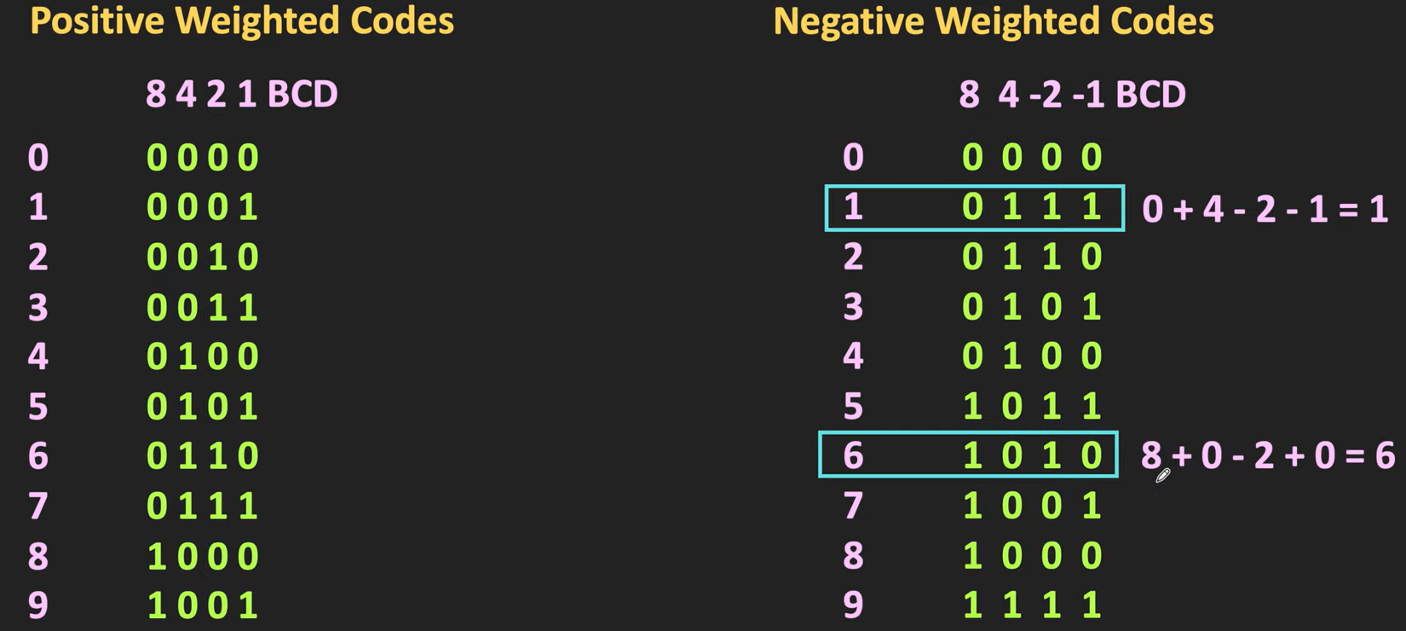

Slide 17
It is important to realize that BCD numbers are decimal numbers and not binary numbers, although they use bits in their representation.
The only difference between a decimal number and BCD is that decimals are written with the symbols 0, 1, 2, c, 9 and BCD numbers use the binary code 0000, 0001, 0010, c, 1001.
The decimal value is exactly the same.
Decimal 10 is represented in BCD with eight bits as 0001 0000 and decimal 15 as 0001 0101.
The corresponding binary values are 1010 and 1111 and have only four bits.

Slide 18
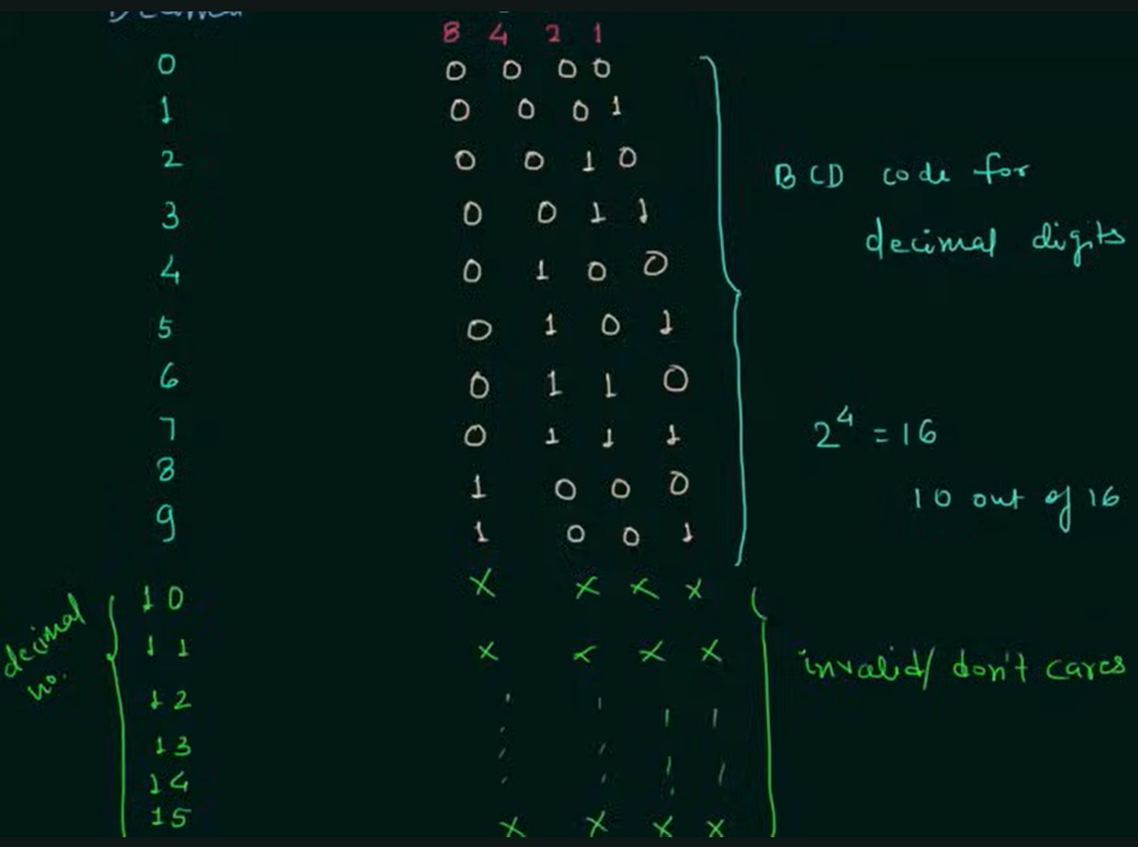

Slide 19
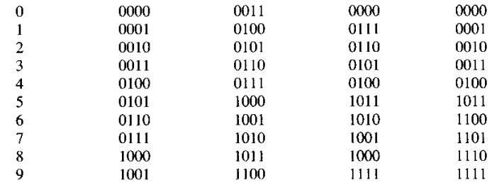
Set of n-bit string represent a number called code
A particular combination of n-bit value is codeword
BCD (Binary coded Decimal) is straight assignment of binary equivalent
BCD code ranges from 0-9
Excess-3 code is self complimentary code
Decimal Digit | BCD Code 8 4 2 1 | Excess-3 | 8 4 -2 -1 | 2 4 2 1

Slide 20
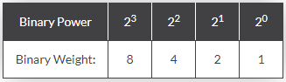
BCD
BCD the binary number formed by four bit 0000-1001
Each digit represented by separate 4 bit
BCD, is process for converting decimal numbers into their binary equivalents
Advantage
Allows easy conversion between decimal and binary form.
Disadvantage
States between 1010 (decimal 10), and 1111 (decimal 15) are not used.
Decimal to BCD
357₁₀ = 0011 0101 0111 (BCD)
85₁₀ = 1000 0101 (BCD)
572₁₀ = 0101 0111 0010 (BCD)
8579₁₀ = 1000 0101 0111 1001 (BCD)
BCD to Decimal
1001₂ = 1001_{BCD} = 9₁₀
1000111₂ = 0100 0111_{BCD} = 47₁₀
10100111000.101₂ = 0101 0011 0001.1010_{BCD} = 538.625₁₀

Slide 21
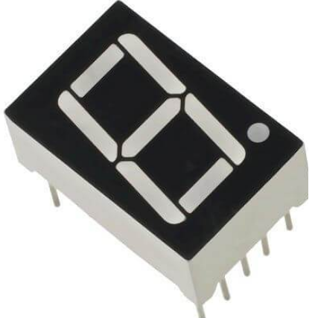
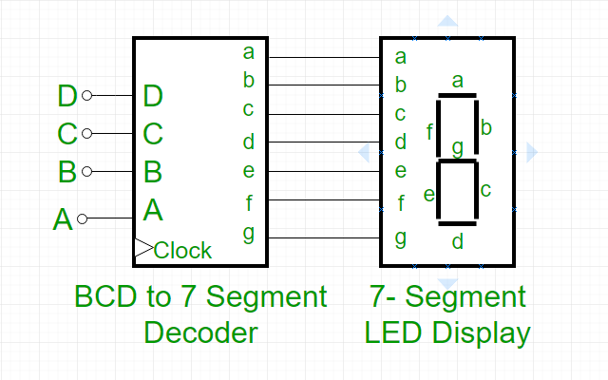

Slide 22
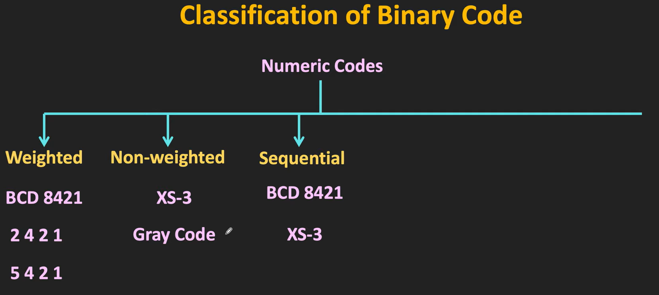

Slide 23
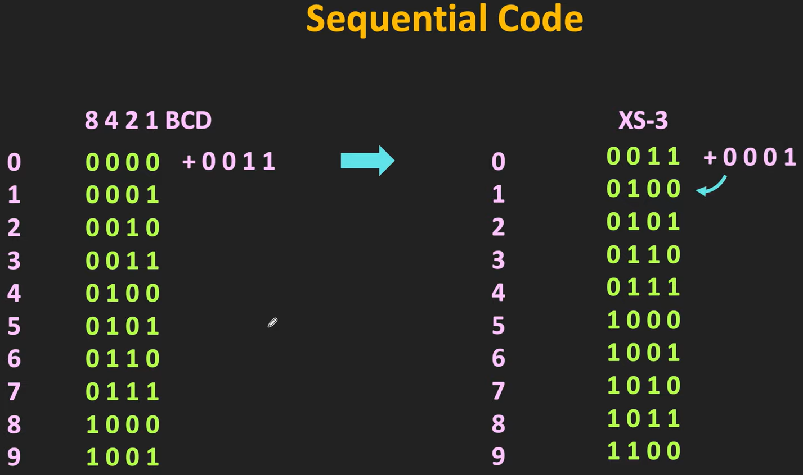

Slide 24
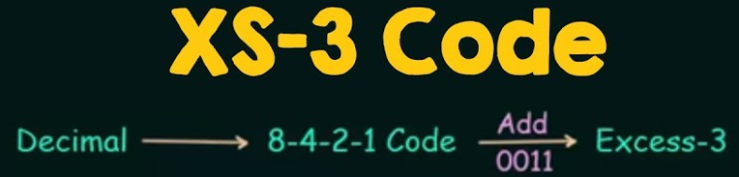

Slide 25
XS-3 code
A non-weighted BCD code
A 4-bit code
A sequential code
Each binary codeword is corresponding to 8421 code + 0011.
Has 6 invalid states (0,1,2,13,14,15)

Slide 26
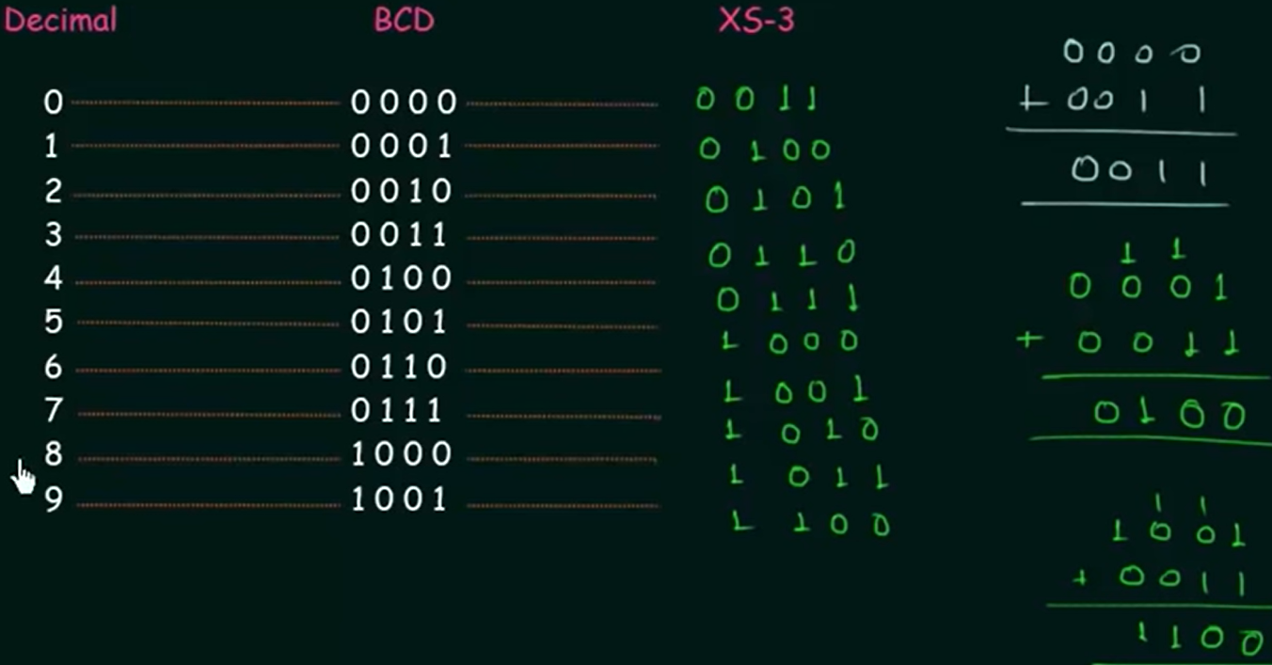

Slide 27
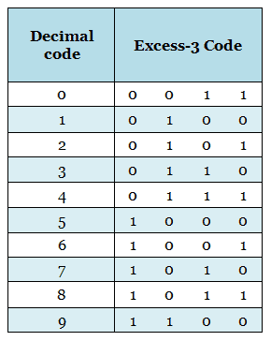
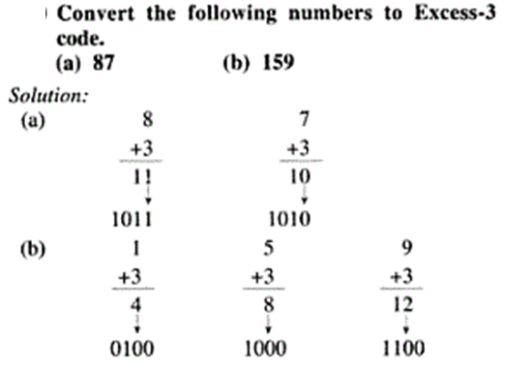
Excess-3 Code
Made by adding 3 with the equivalent decimal of a binary number and again converting into binary

Slide 28
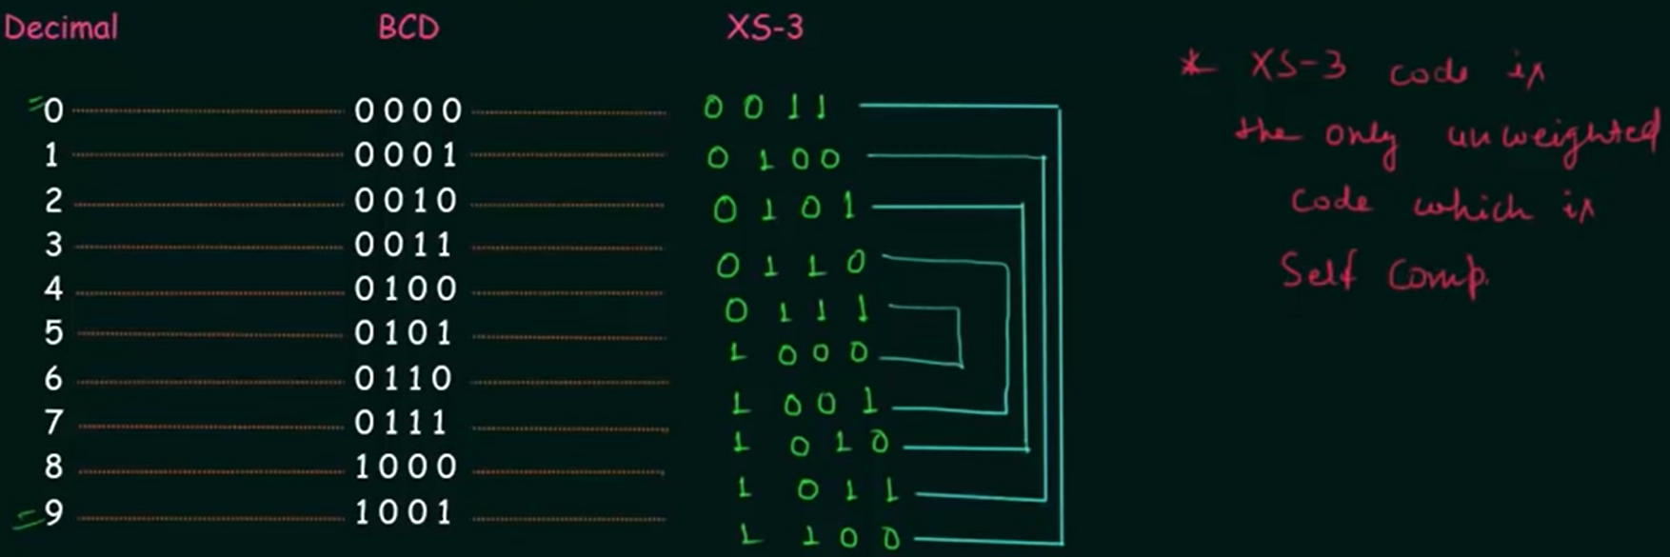
XS-3 codes are self-complementing

Slide 29
How to check whether weighted codes are self-complementing or not?
Add the weights of all 4 bits.
If sum = 9, only then it is self complementing

Slide 30
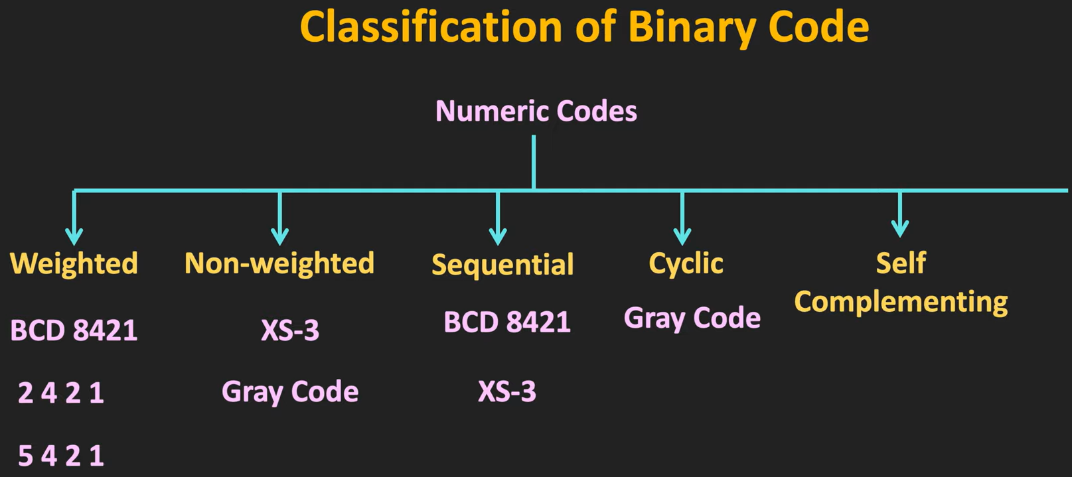

Slide 31
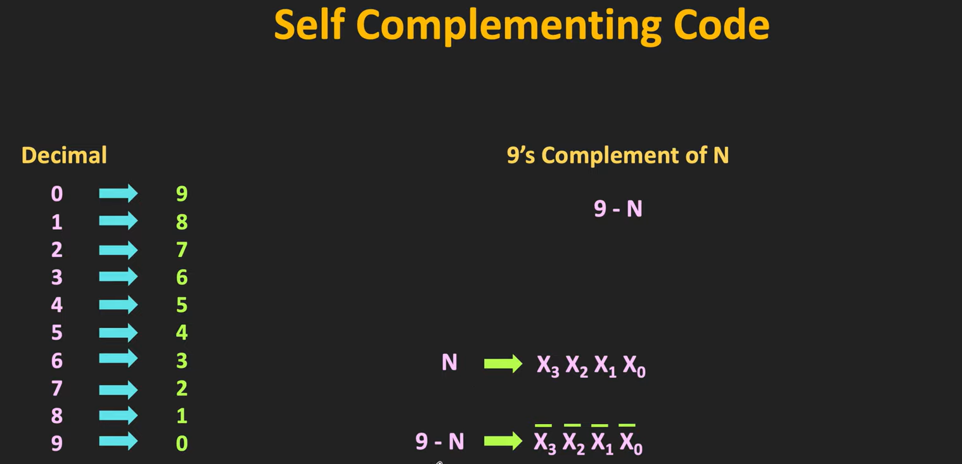

Slide 32
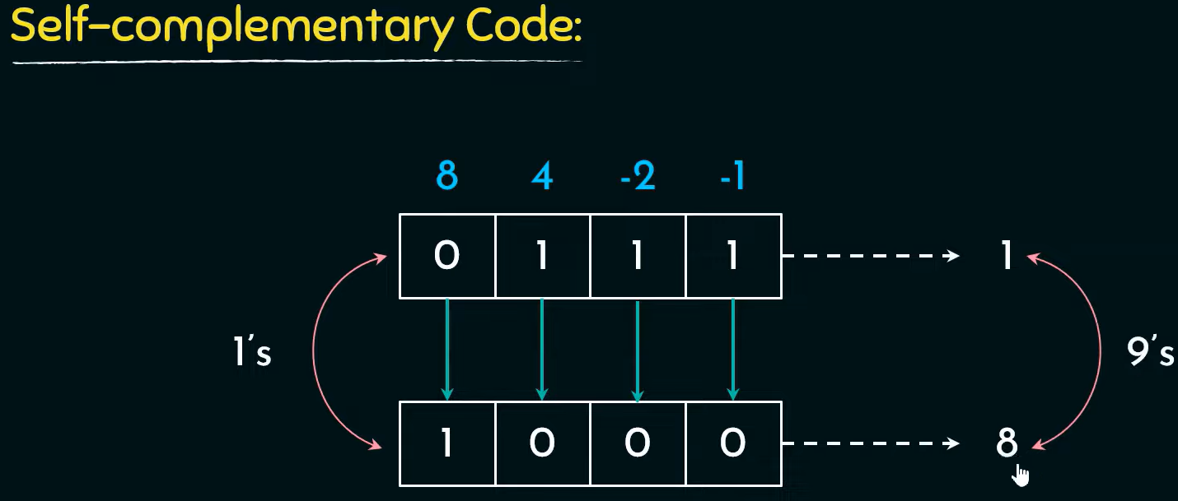

Slide 33
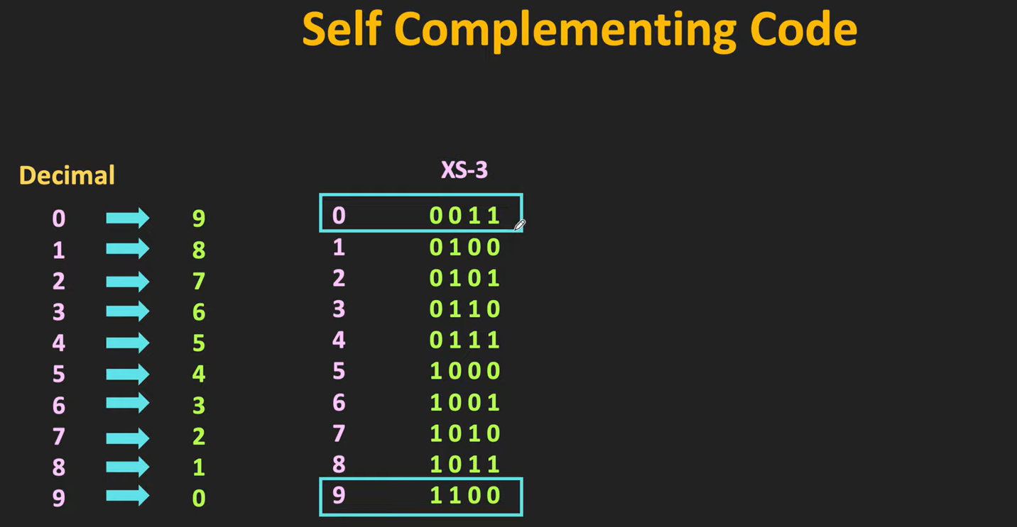

Slide 34
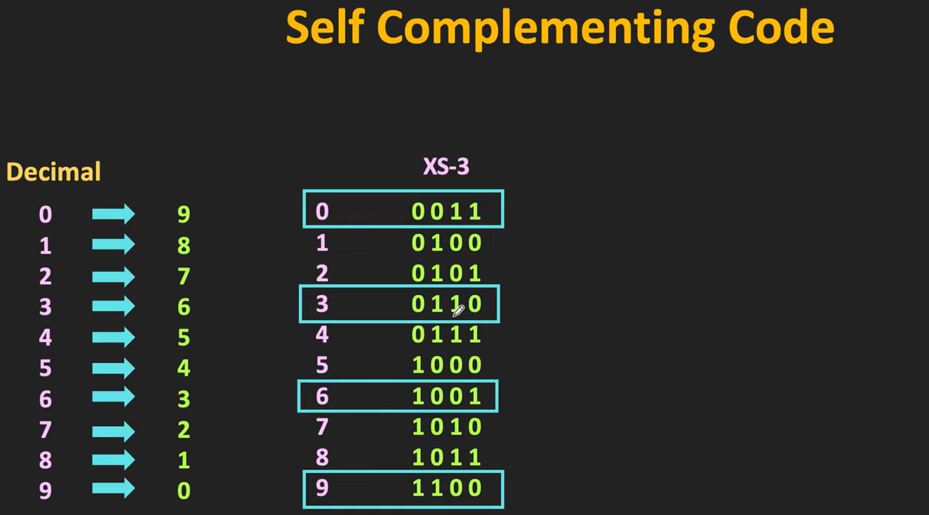

Slide 35
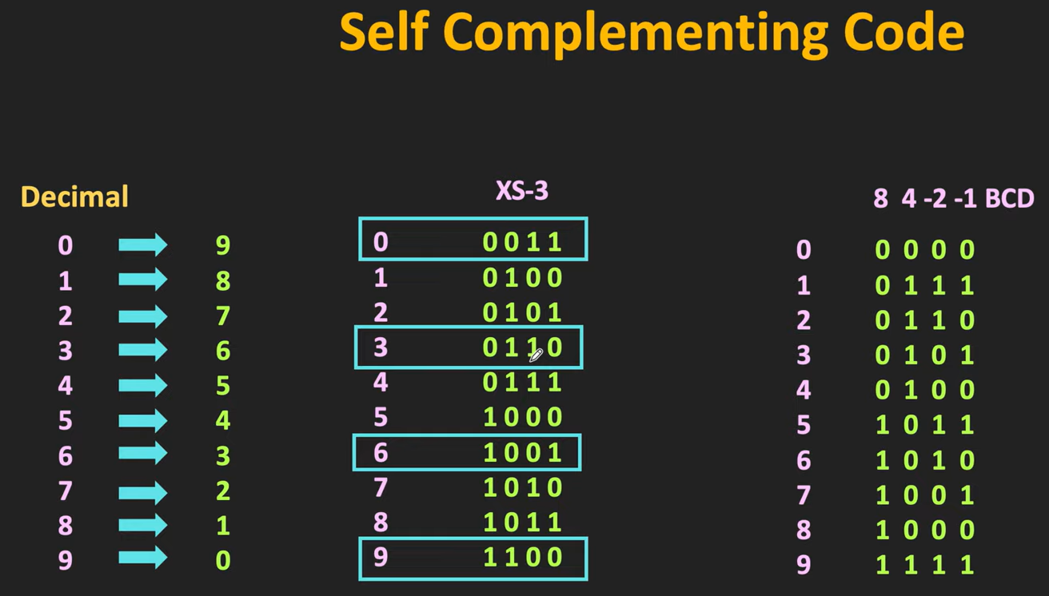

Slide 36
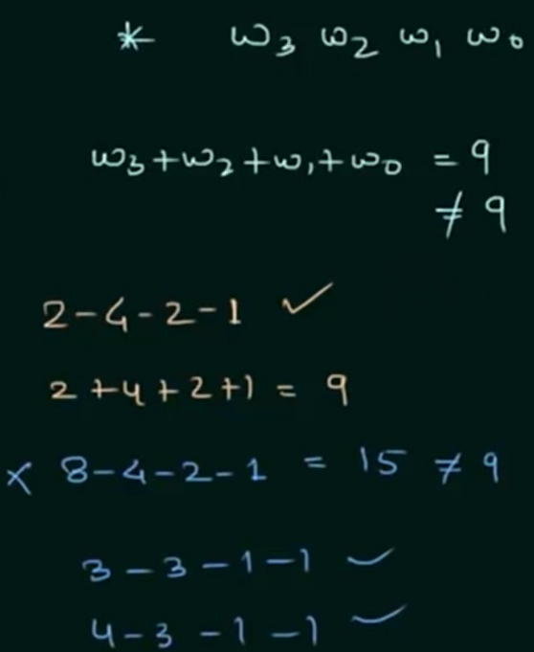





Slide 37
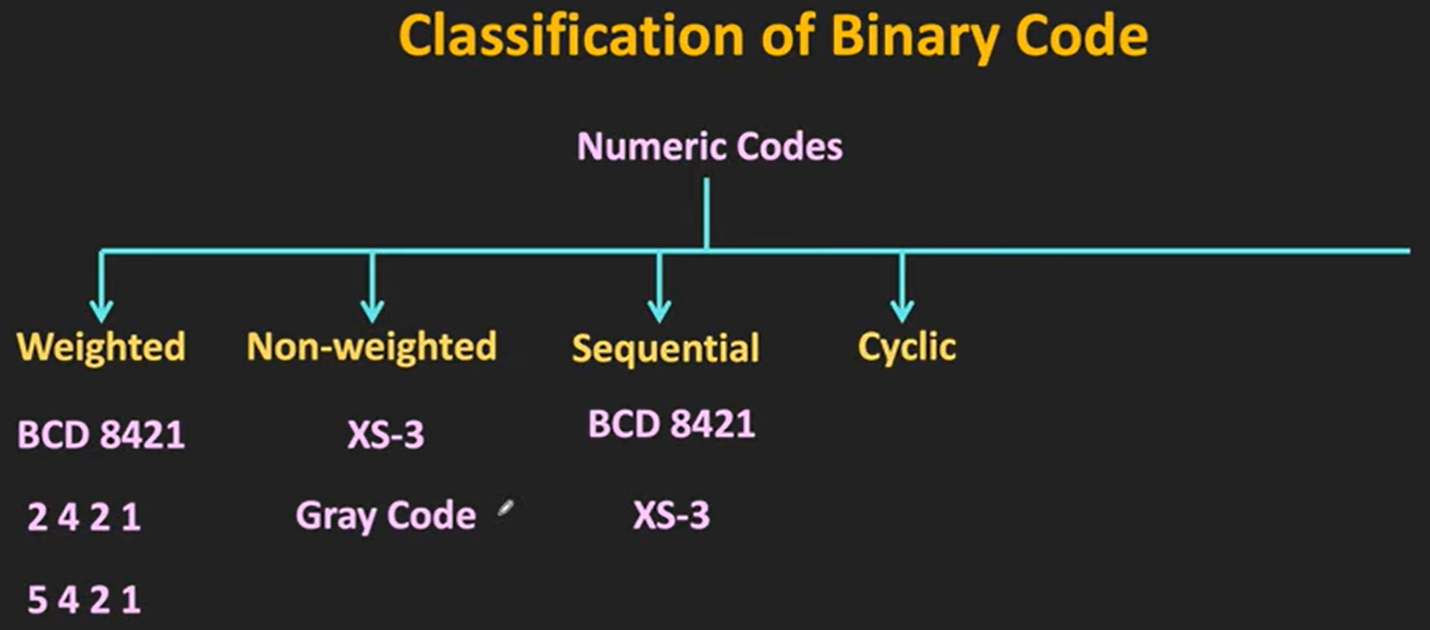

Slide 38
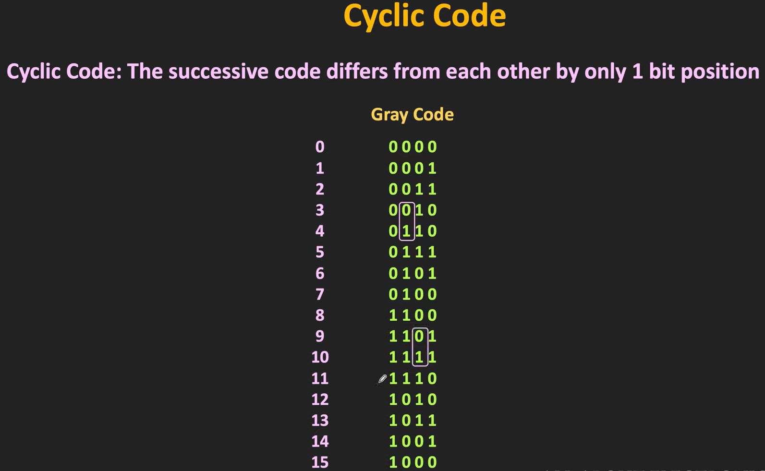

Slide 39
Gray Code
A non-weighted code
A cyclic code
Not a BCD code
Not suitable for arithmetic operations

Slide 40
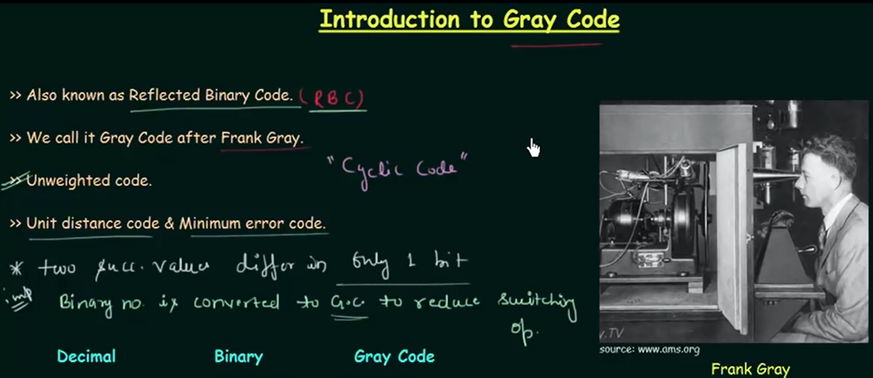

Slide 41
How does Gray code reduce switching operations?

Slide 42
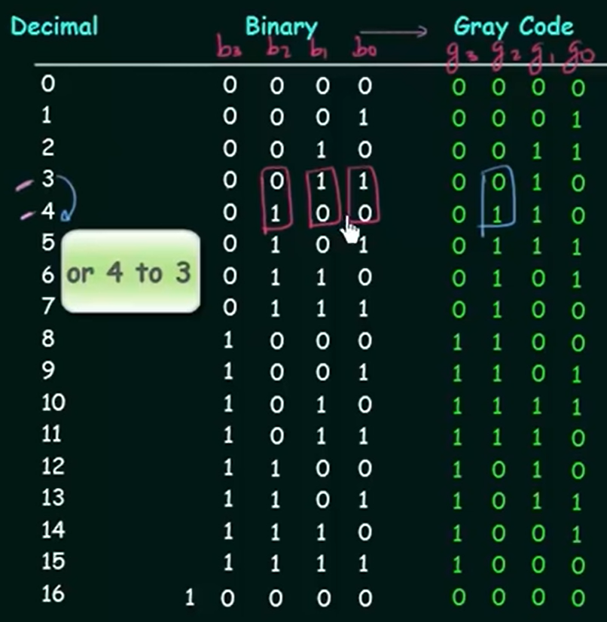



Slide 43
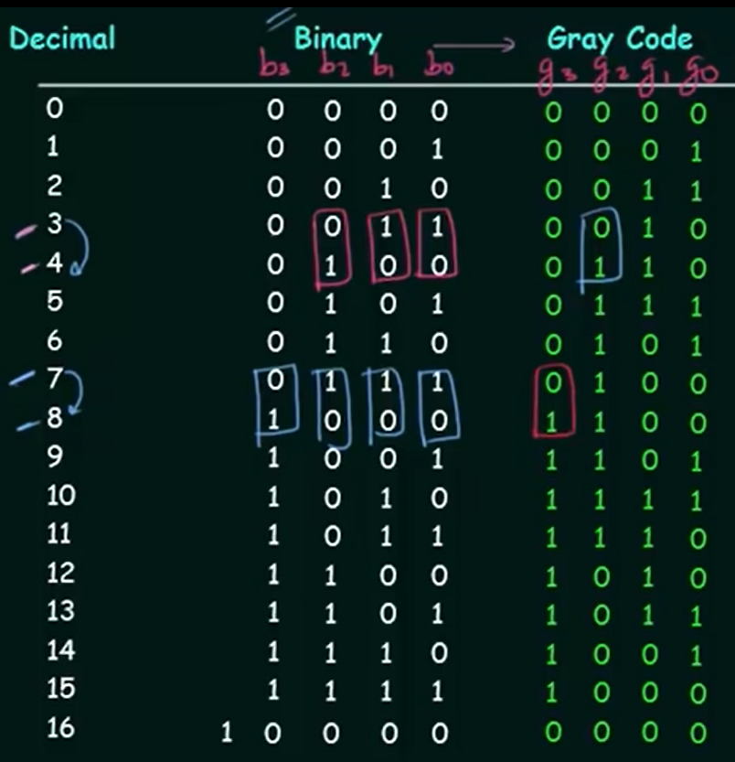



Slide 44
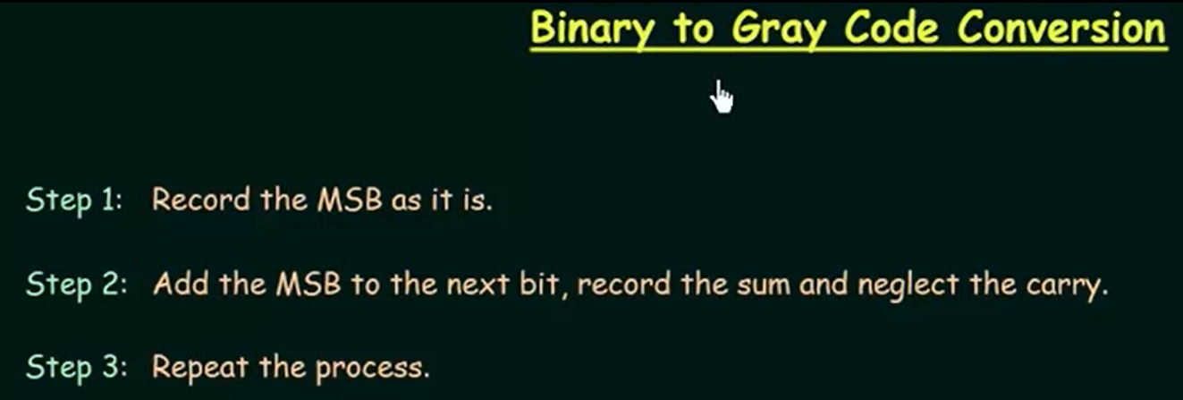



Slide 45
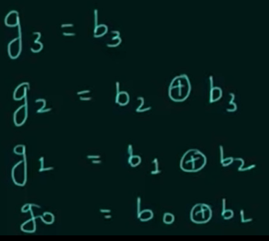

Slide 46
Convert binary 0110 to Gray code.

Slide 47
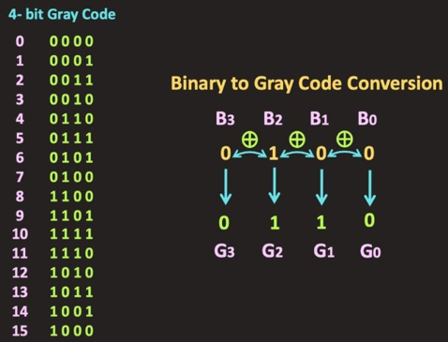

Slide 48

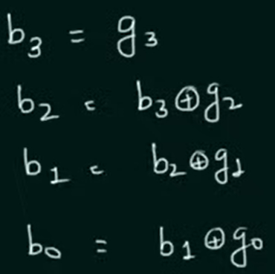

Slide 49
Convert Gray 0101 to binary code.

Slide 50
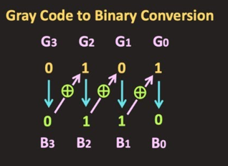

Slide 51
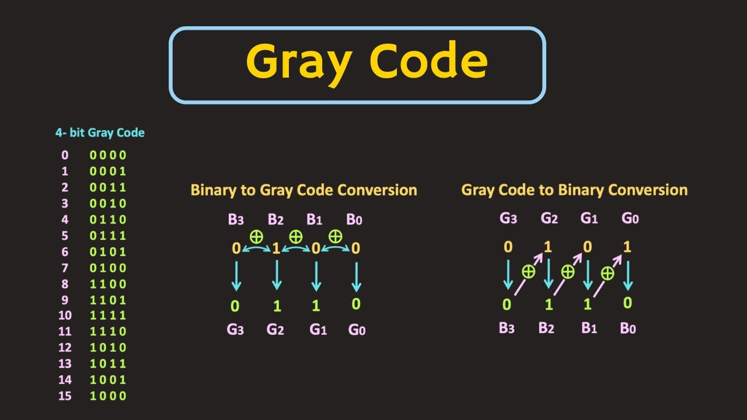

Slide 52
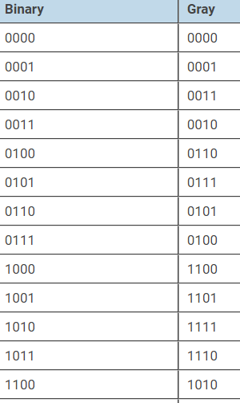
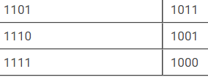
Convert Binary code 100101 to Gray

Slide 53
Quiz
Feature of GRAY code is
a) All digits change between counts b) Two digits change between counts c) Only one digit changes between counts d) Alternate digit changes between counts

